Slide 1
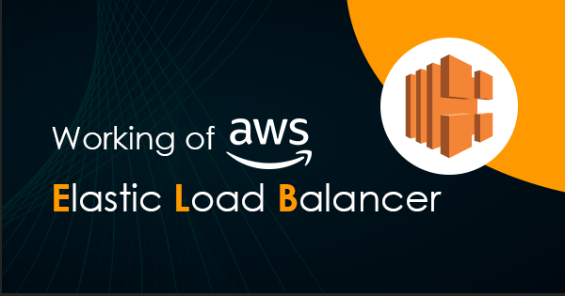

Slide 2

Topics
Sticky sessions
Cross zone load balancing
Path patterns
Auto Scaling

Slide 3

What Sticky sessions?
Classic load balances routes each request independently to the registered EC2 instance with the smallest load.
Sticky sessions allows you to bind a user's session to a specific EC2 instance.
This ensures that all requests from the user during the session are sent to the same instance.
If your application is saving something locally on your EC2 instance or it's writing a file
You can enable sticky sessions for application/network load balances as well, but the traffic will be sent at the target group level

Slide 4
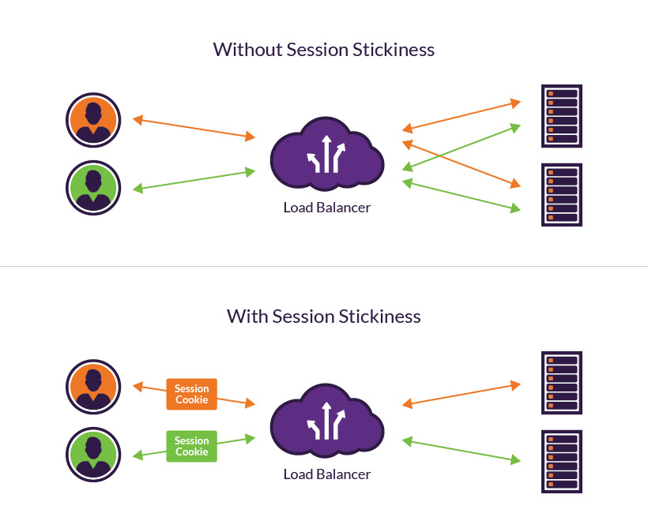
What Sticky sessions?

Slide 5
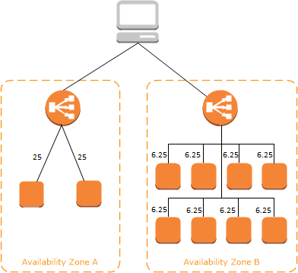
No Cross-zone load balancing
50%
50%

Slide 6
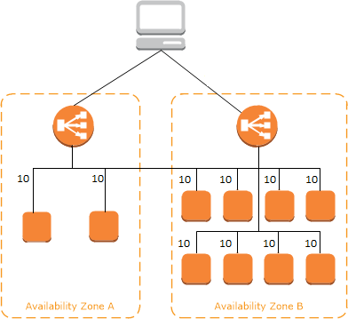
Cross zone load balancing
50%
50%

Slide 7
Path patterns
You can create a listener with rules to forward request based on the URL path.
This is known as path-base routing.
If you are running micros services, you can reroute traffic to multiple backend services using path-based routing.
For example, you could route a general request to one target group and request to render images to another target group.

Slide 8
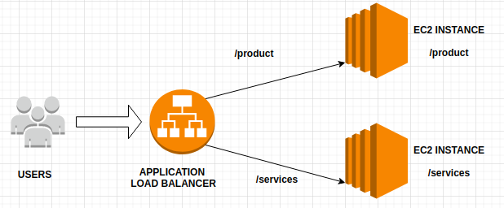
Path patterns

Slide 9
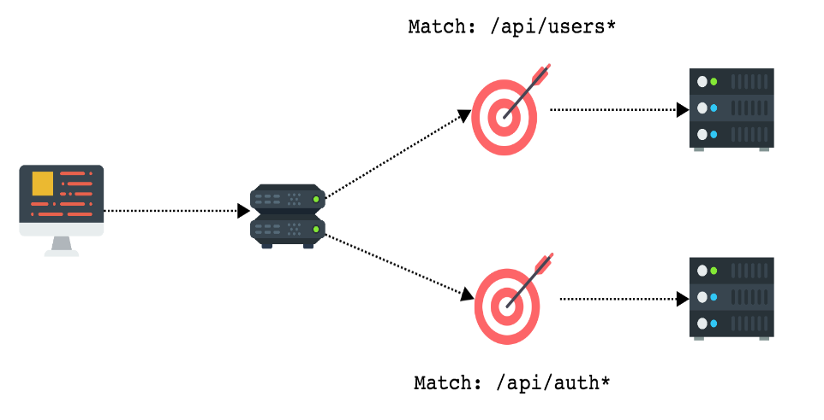
Path patterns

Slide 10
Exam Tips:
Sticky sessions enables your users to stick to the same EC2 instance.
Can be useful if you're storing information locally to that instance.
Cross zone load balancing enables you to load balance across multiple Availability Zones
Path patterns allows you to direct traffic to different EC2 instances based on the URL contained in the request

Slide 11
Thank you

